Slide 1
Document @One Place
15mca001 Akash Shah
15mca012 Dhruti Shukla
Guided By Prof. Smita Agrawal

Slide 2
Overview Of System
In this application end user (with gmail/Firebase id) can store its useful document @one place and access from anywhere. If need he/she can share the document with help of app.

Slide 3
Introduction
A Document @one place is stored your all type data at one place and access through different place.
This is a cloud-based web application.
This application can store any type of file.

Slide 4
Scope
This is Hybrid mobile application so it available on different platform e.g. like android, ios, web and other etc.
This system allow user to store his/her photos, videos, document or other type of documents globally.

Slide 5
Feature of System
Easy Access
Cloud Storage
Security
Organize Documents
File Sharing

Slide 6
Tools And Technology Used
Front End
Ionic framework
Angular js
Cordova plugins
Html
Css
JavaScript
Back End
Firebase
Hardware Requirement
Any mobile device

Slide 7
Why Ionic Framework
Ionic is open source framework used for developing hybrid mobile application.
We can package our application for IOS,android,windows phone and Firefox os which can save lot of working time

Slide 8
Angular Js
Ionic is using AngularJS MVC architecture for building rich single page applications optimized for mobile devices.
Cordova plugins
Cordova is a means of packaging html/css/js into apps that can run on mobile and desktop devices and provides a plugin architecture for accessing native functionality beyond the reach of JS run from a web browser.

Slide 9
Firebase
Is a scalable, real-time and flexible backend for your application.
It allows the developer to build rich collaborative application without the hassle of managing or writing server-side code.
Store and sync with our NoSQL cloud dababase
Data is stored as JSON
It is synced to all connected clients in real-time

Slide 10
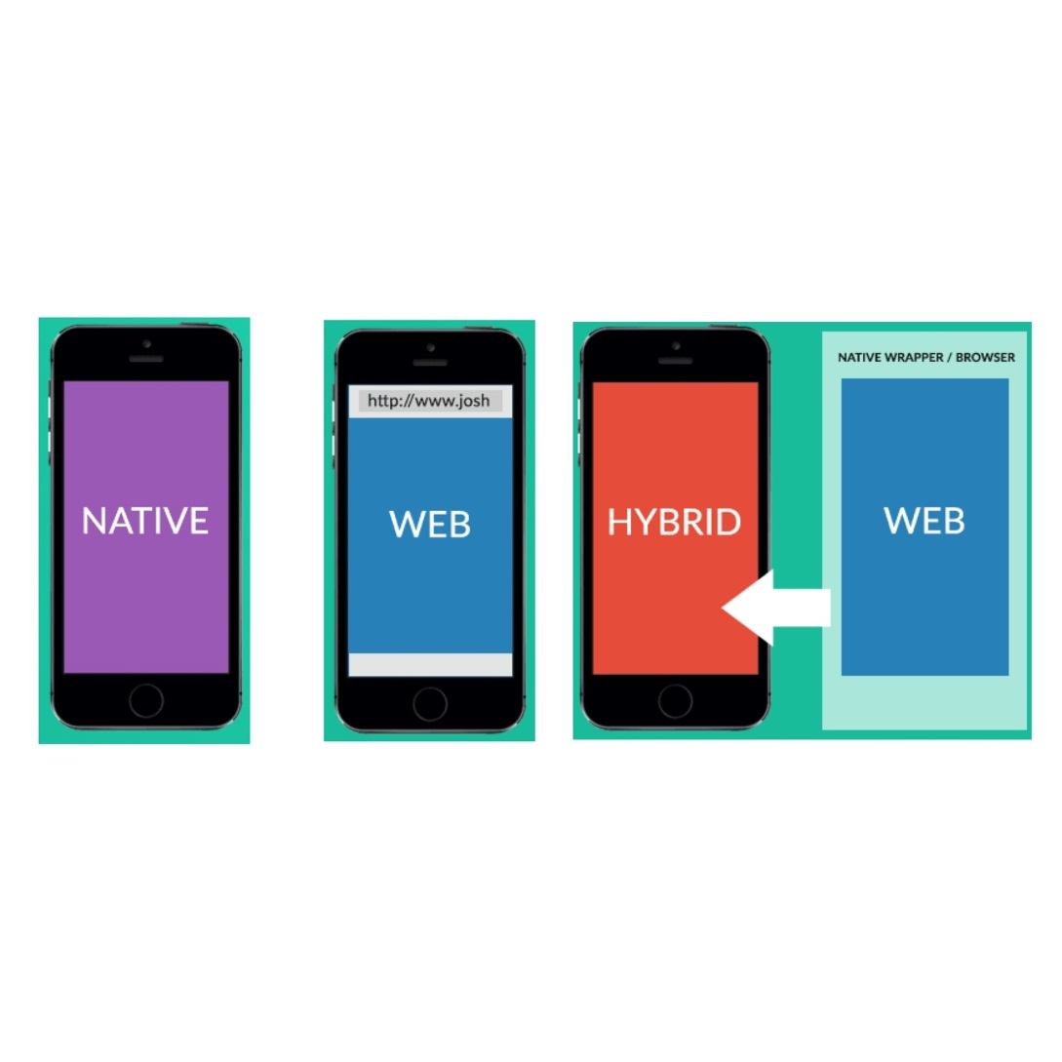
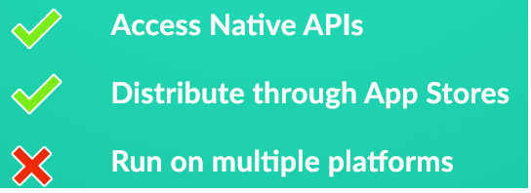
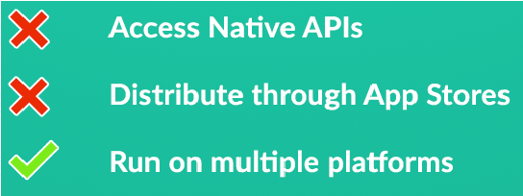
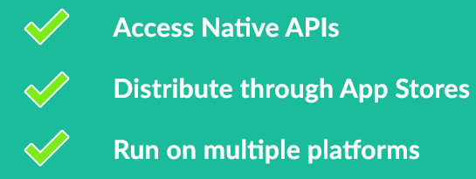
Difference

Slide 11
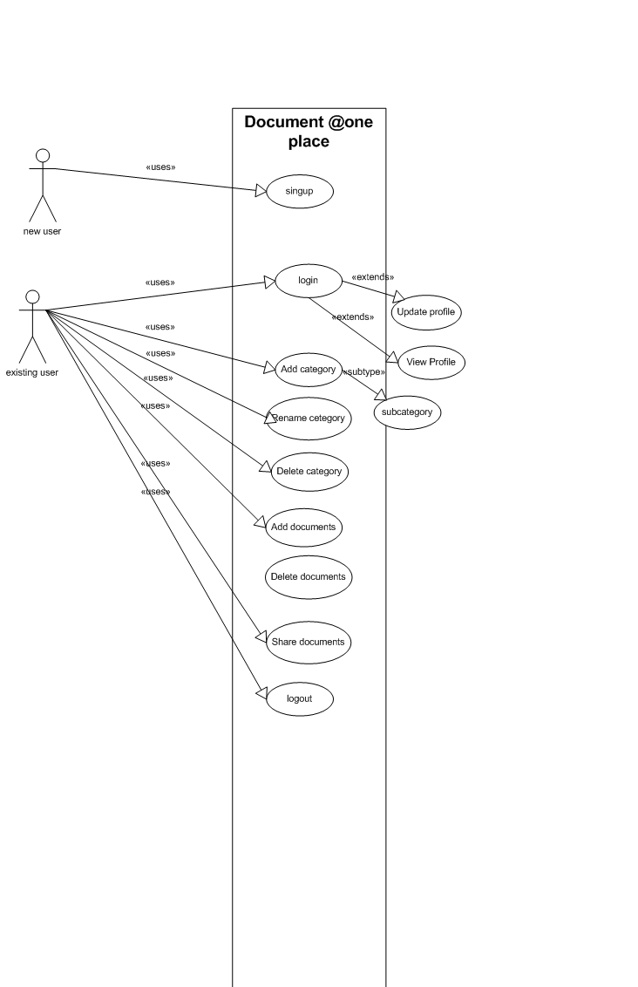
Use Case Diagram

Slide 12
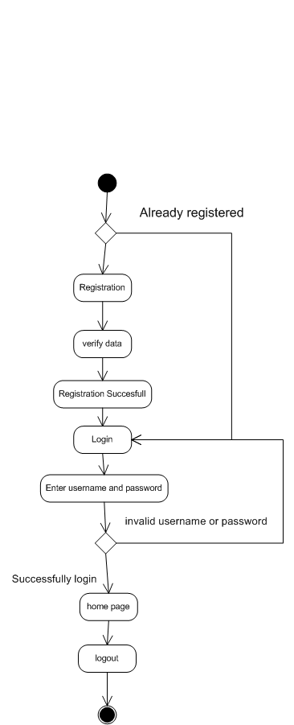
Activity Diagram

Slide 13
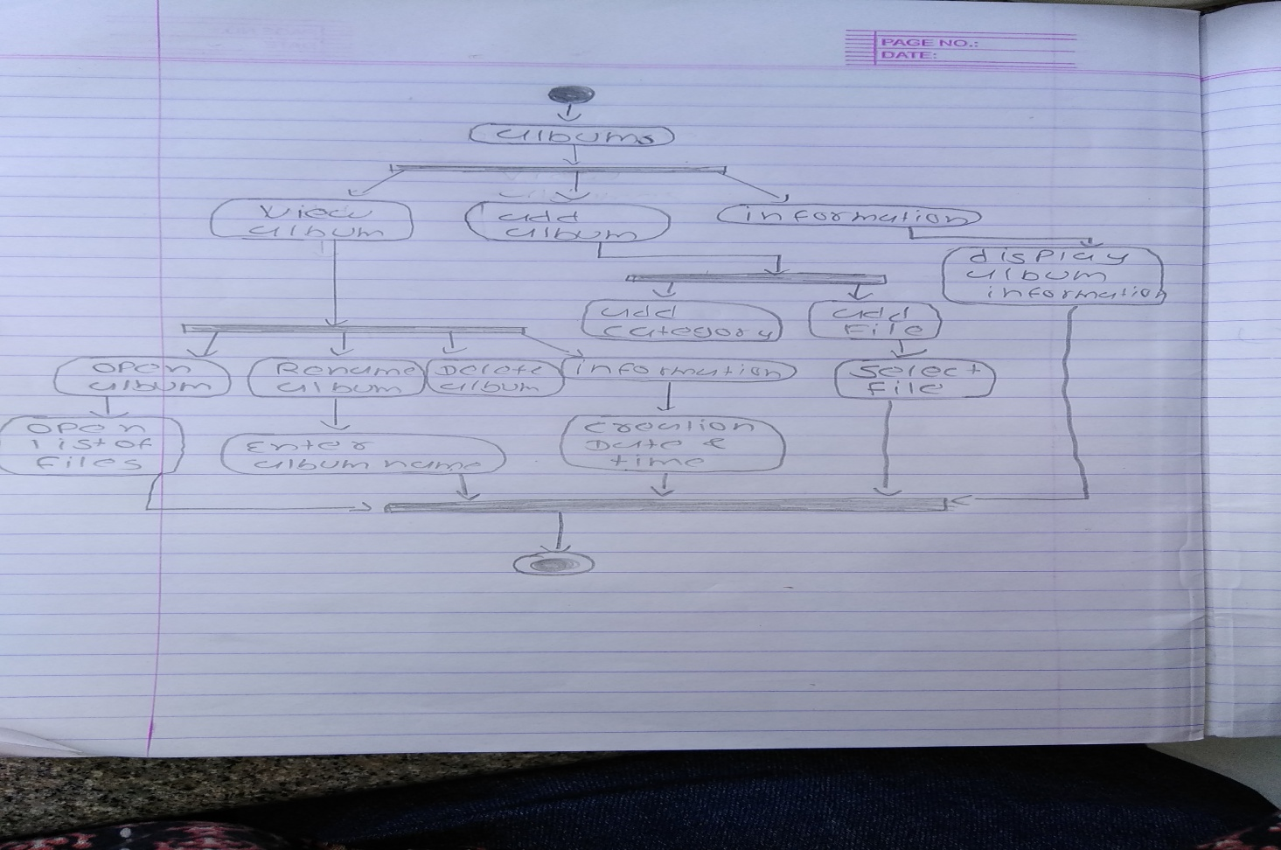
Albums Activity

Slide 14
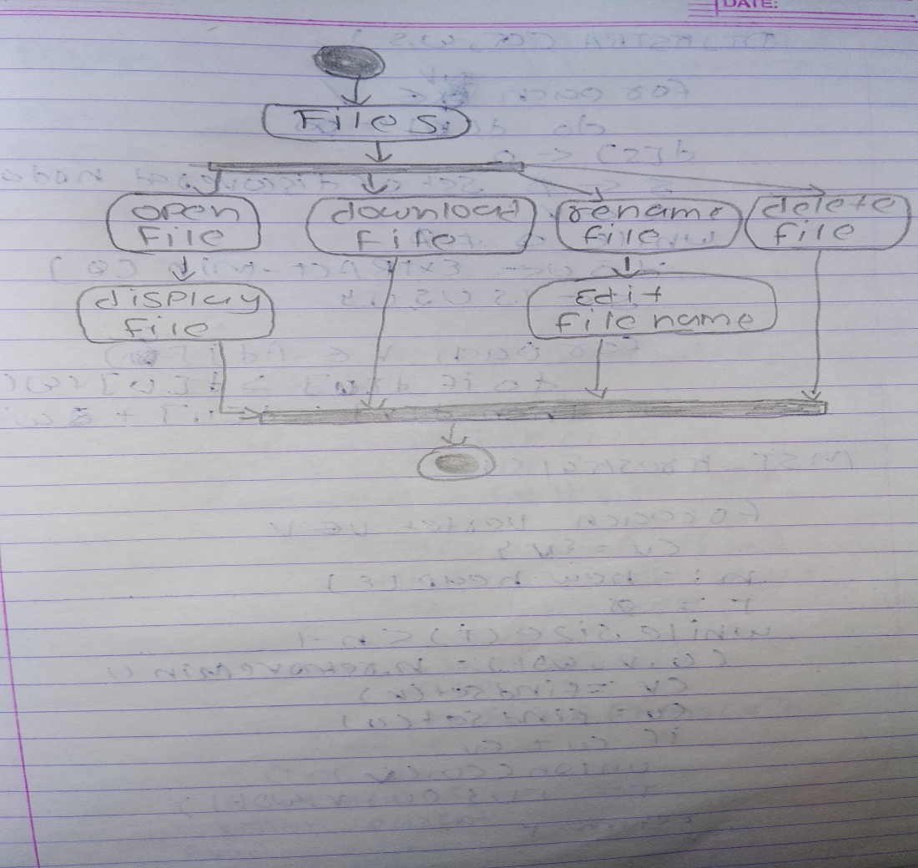
File Activity

Slide 15
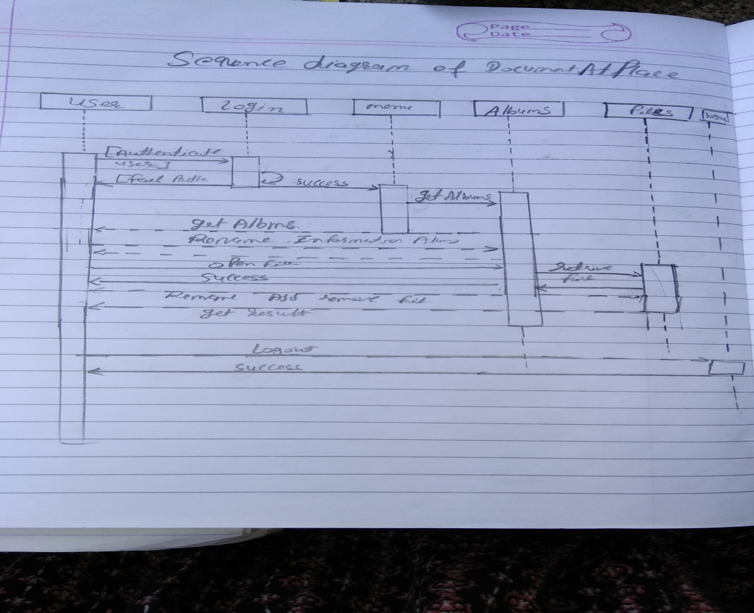
Sequence Diagram

Slide 16
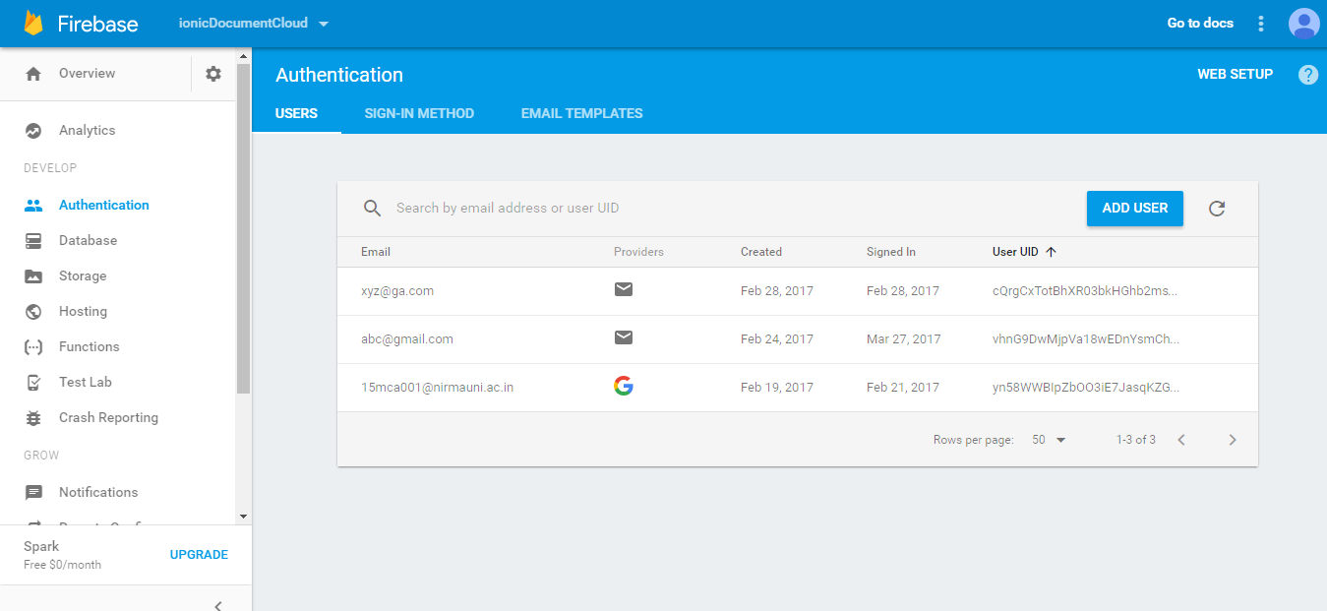

Slide 17
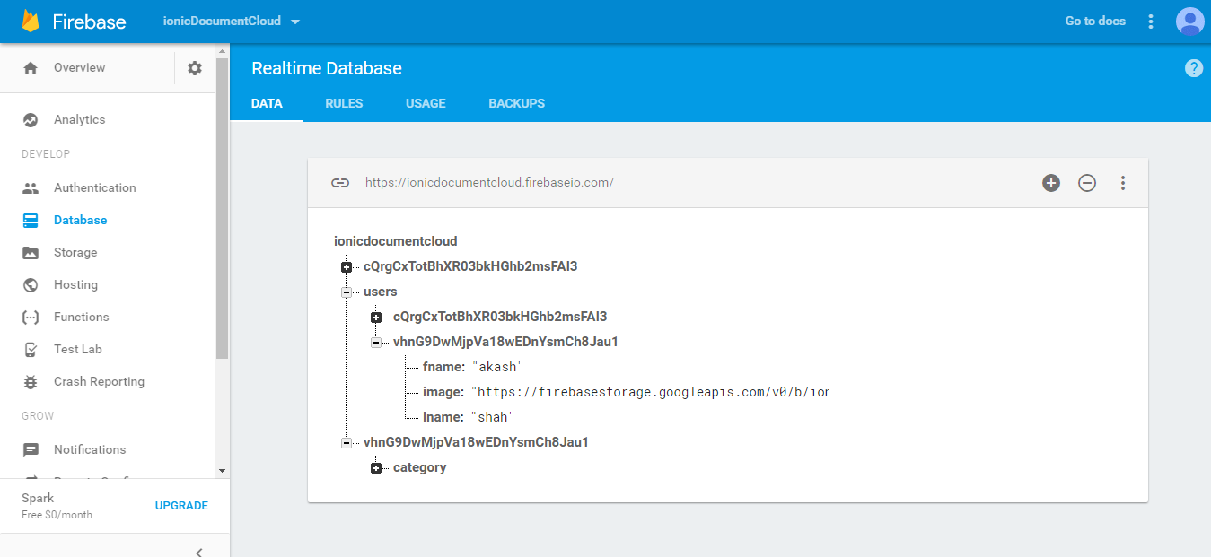
In user table user can store details like firstname,lastname,profile photo

Slide 18
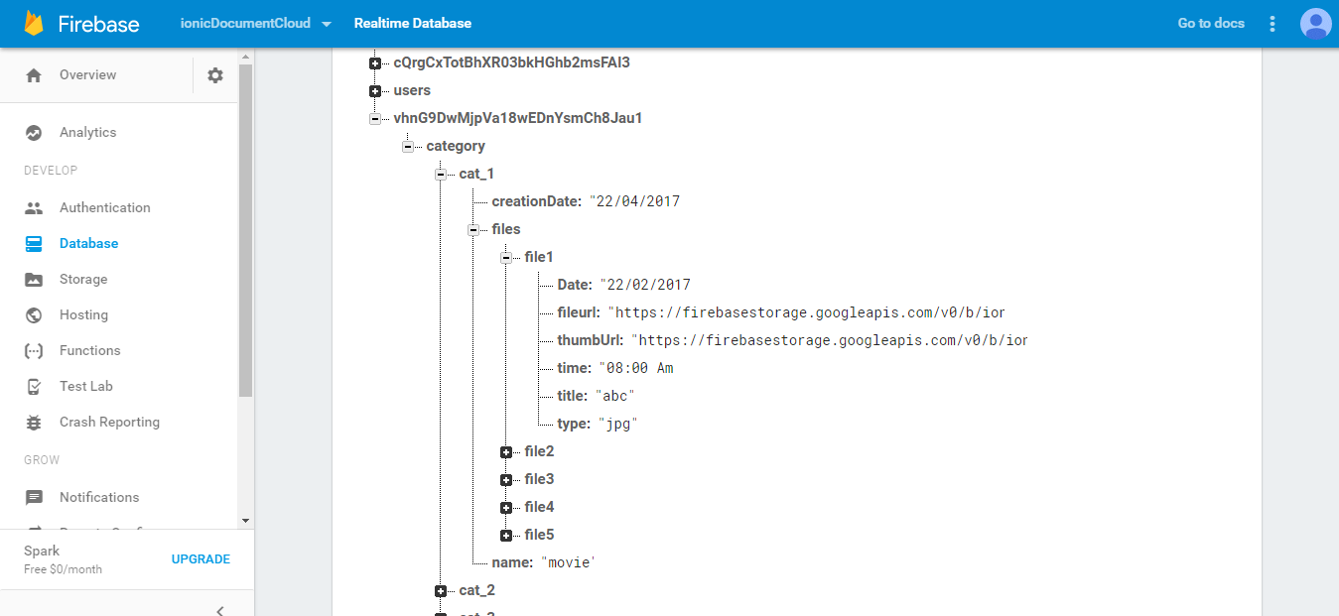
particular user have different category of album each album have 1 more documents

Slide 19
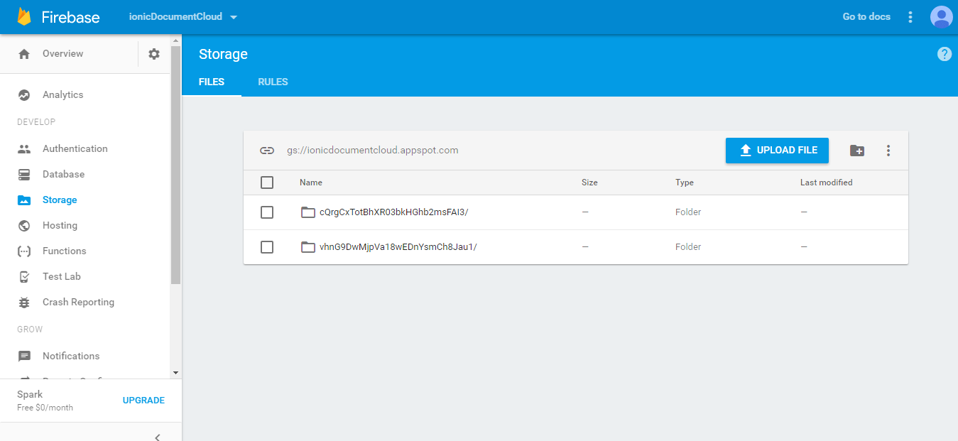

Slide 20
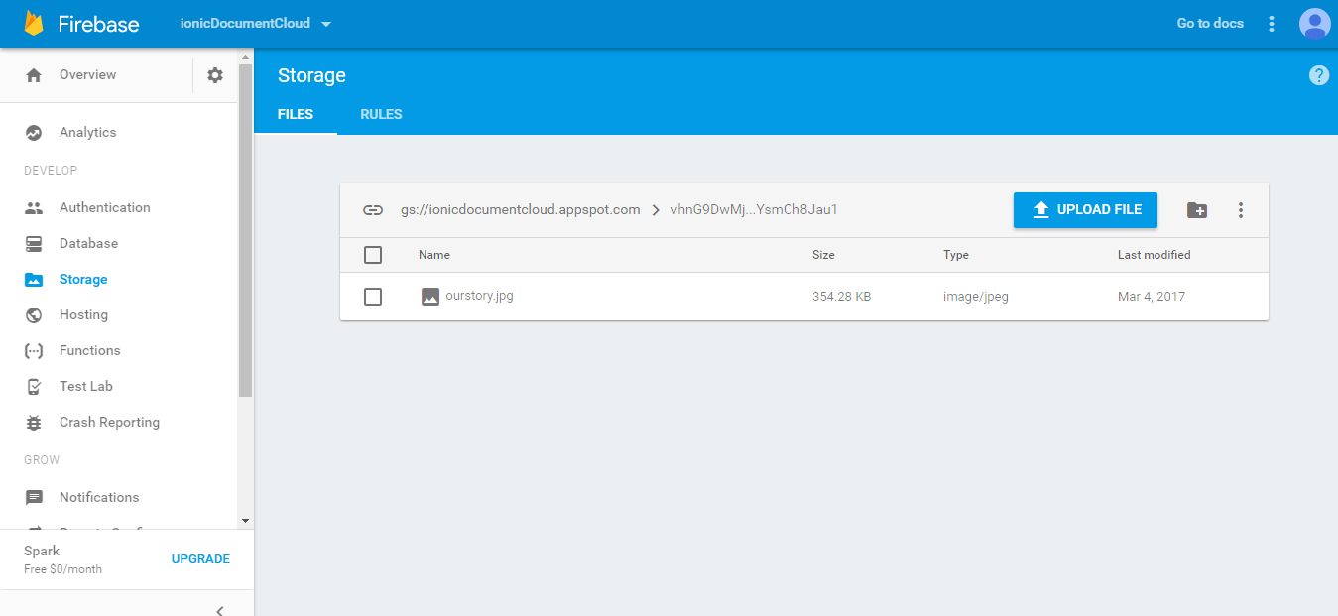

Slide 21
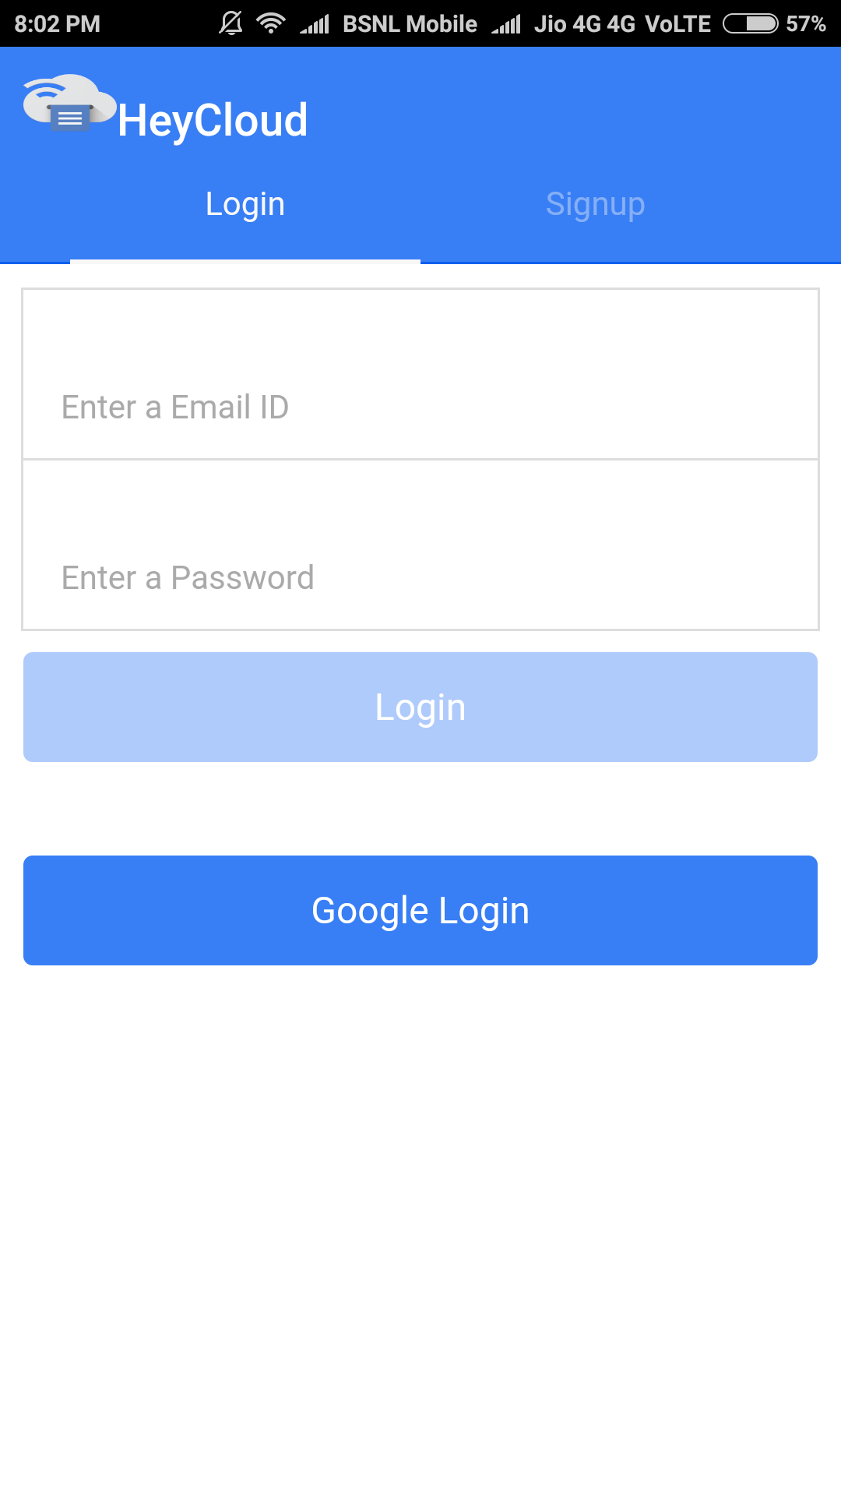
Login page for already registered user

Slide 22
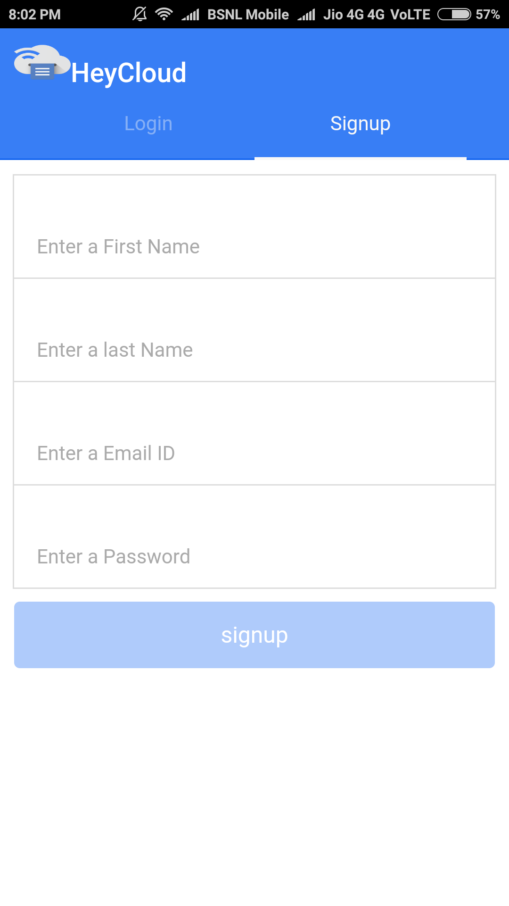
Registration page for new user

Slide 23
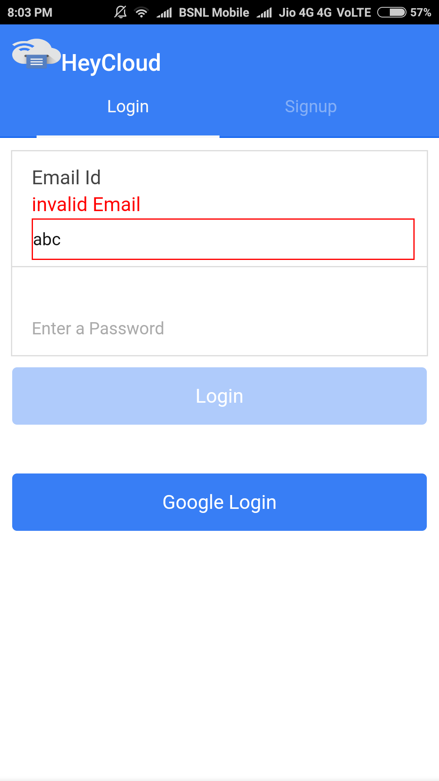
validation constraints like @ symbol is compulsory

Slide 24
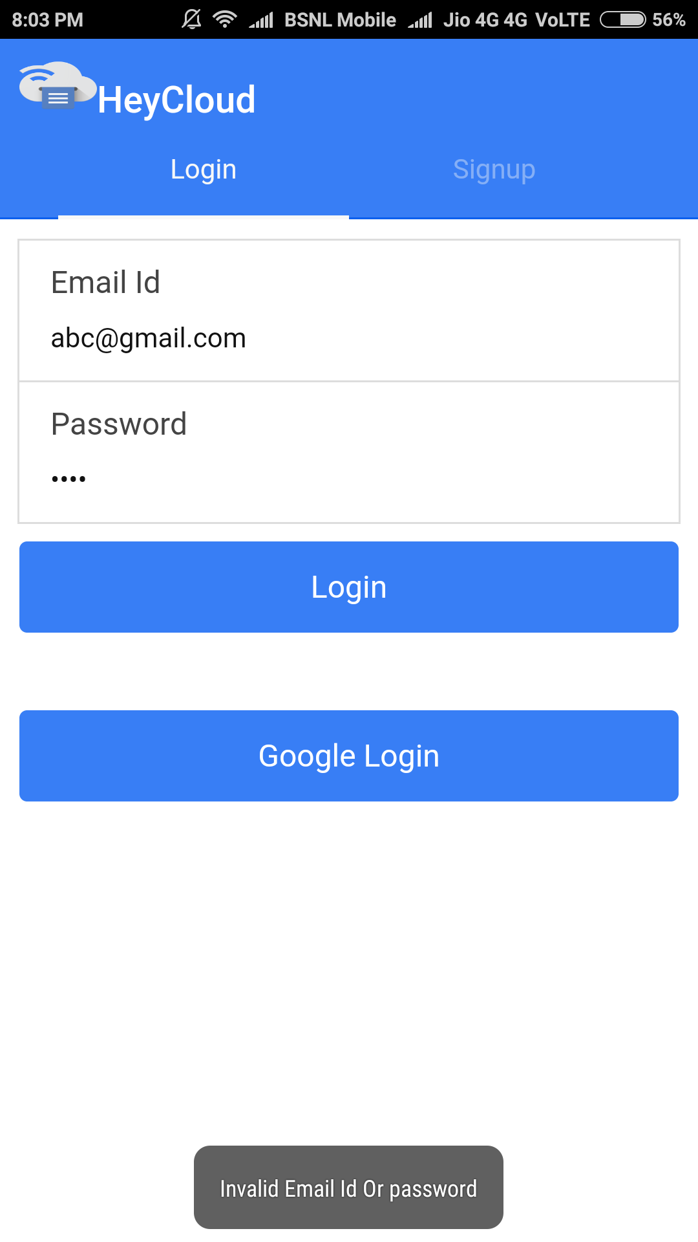
After checking in database if Email or password is invalid then it will display error message.
For processing purpose we use loading bar

Slide 25
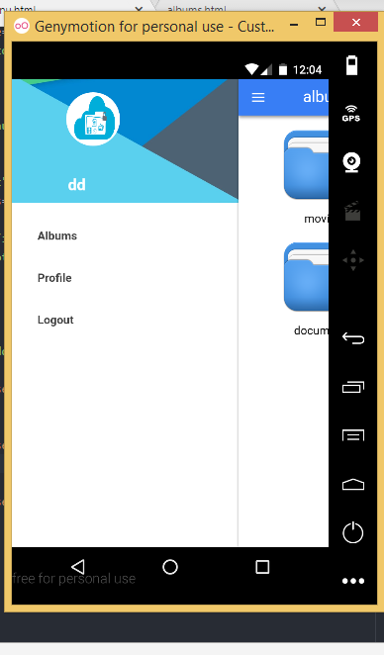
After successful login home page

Slide 26
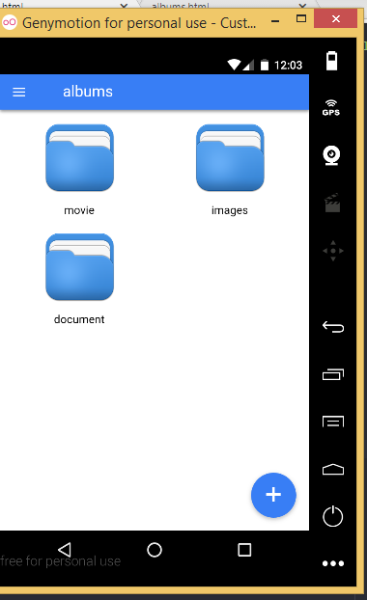
Different type of albums are manage

Slide 27
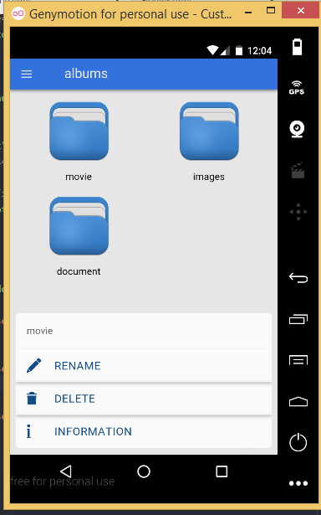
We can rename or delete our albums also show detail information about album

Slide 28
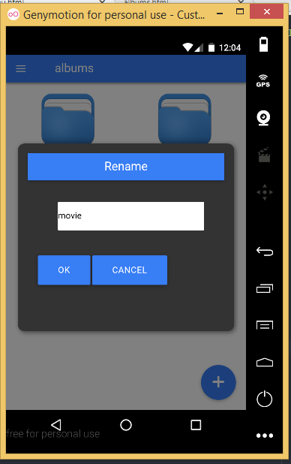

Slide 29


Slide 30
